Slide 1
Report of Agile2014
As a Speaker and a Reporter
of the latest Agile in the world
Aug/07/2014
Hiroyuki Ito
Development Process Optimization Department, Rakuten, Inc.
http://www.rakuten.co.jp/

Slide 2
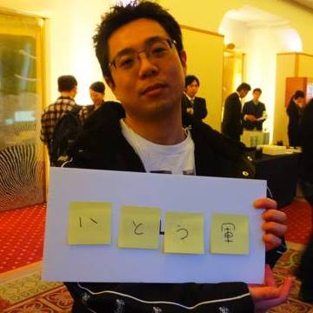
About me
Hiroyuki Ito
(The Hiro)
@hageyahhoo
Test-Driven
Development Group

Slide 3
What is Agile2014?

Slide 4
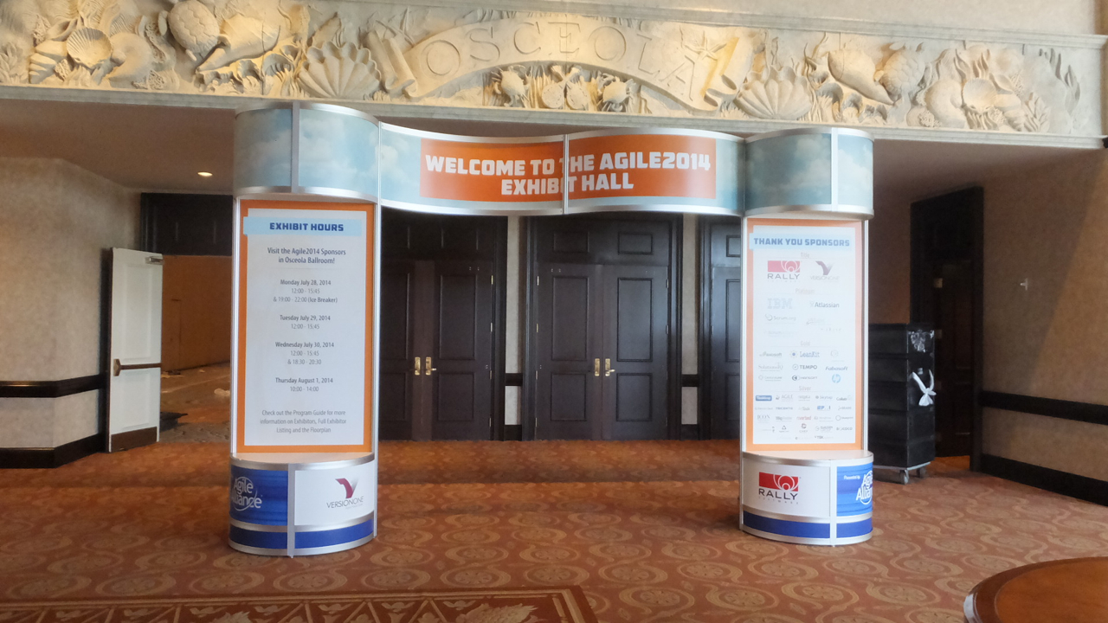



The world’s largest Agile Conference
WALL ATDD
WALL TDD
WALL CI/CD

Slide 5
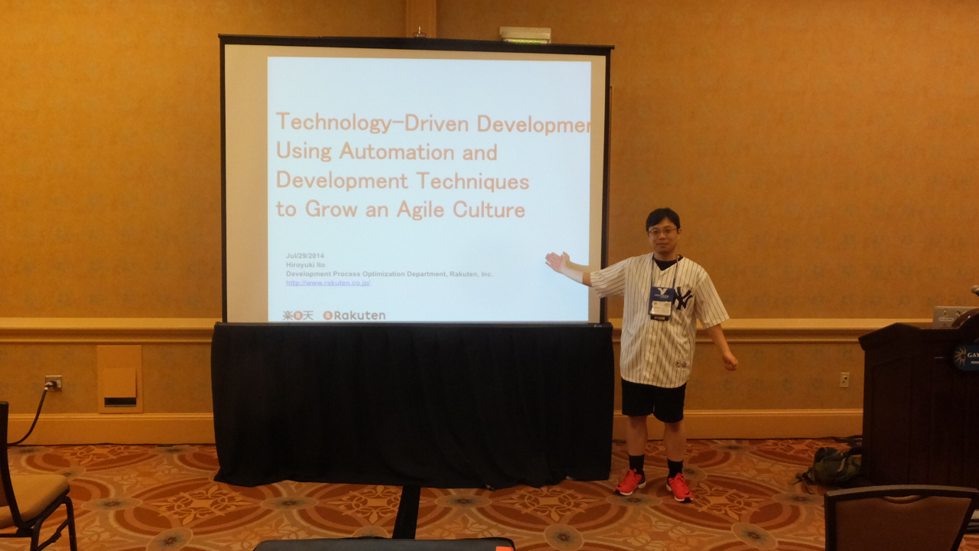
Attended as a session speaker!

Slide 6
Agenda
1. Basic Information of Agile2014
2. My Presentation
3. The Latest Trend of Agile
4. Conclusions

Slide 7
1. Basic Information of Agile2014
2. My Presentation
3. The Latest Trend of Agile
4. Conclusions

Slide 8
Basic information
Location | Orlando, Florida, U.S.
Duration | 4.5 days
Attendees | Approximately 2000 persons
Sessions | 272 sessions
Session Speakers | Over 280 persons

Slide 9
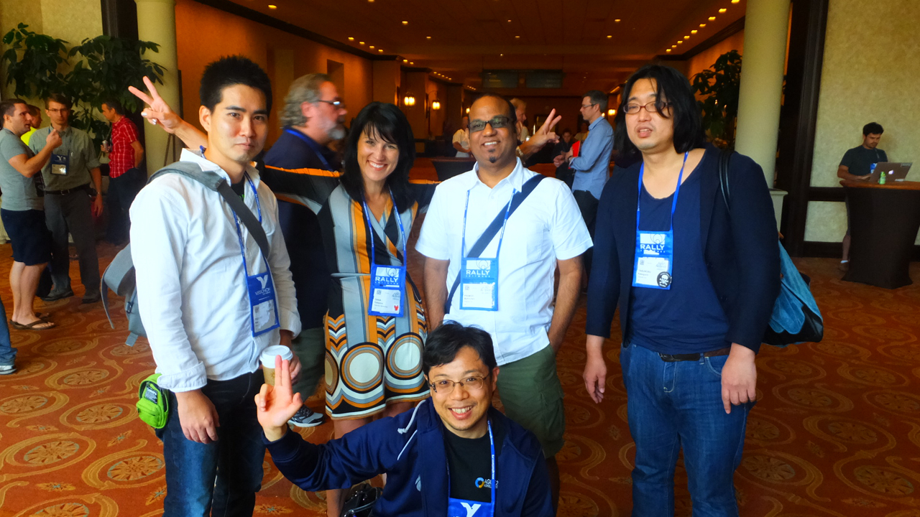
Rakuten all superstars!
Dana (R Marketing)
Pramod (PJM)
Abex (BDD)
Yasnob (TDD)
TheHiro (TDD)

Slide 10
Trend of sessions
Category | Sessions | Memo
Agile Bootcamp | 7
Coaching & Mentoring | 16
Collaboration Culture & Teams | 23
Development Practices & Craftsmanship | 28
DevOps | 15
Enterprise Agile | 28
Experience Reports | 25 | TheHiro make a presentation here.
Keynote | 3
Leadership | 16
Learning | 15
Lightning Talks | 3
Open Jam | 4 | All day event held everyday.
Project Program and Portfolio Management | 24
Research | 9 | Including LT for researchers. 10 min/person.
Special Events | 9 | Including parties.
Stalwarts | 8
Testing & Quality Assurance | 13
User Experience | 11
Working with Customers | 15
Total | 272

Slide 11
Comparison of trends
Category | Sessions |  |  | Memo
 | 2012 | 2013 | 2014
Adoption & Transformation | 26 | 0 | 0 | Divided into “Enterprise Agile”, “Learning”, and so on.
Agile Bootcamp | 7 | 7 | 7
Coaching & Mentoring | 15 | 15 | 16
Collaboration Culture & Teams | 18 | 15 | 23
Crouedsourced | 0 | 14 | 0 | Held only 2013.
Development Practices & Craftsmanship | 16 | 20 | 28
Distrubuted Agile | 5 | 0 | 0
DevOps | 0 | 13 | 15
Emerging Applications of Agile | 5 | 0 | 0
Enterprise Agile | 21 | 19 | 28
Experience Reports | 20 | 14 | 25
Keynote | 3 | 3 | 3
Leadership | 13 | 12 | 16
Lean Startup | 0 | 15 | 0 | Held only 2013.
Learning | 0 | 17 | 15
Lightning Talks | 0 | 0 | 3 | 10 min/person.
Open Jam | 26 | 4 | 4 | Including “Coaches Clinic” in 2012.
Project Program and Portfolio Management | 0 | 25 | 24
Research | 8 | 9 | 9 | Including LT for researchers.
Special Events | 9 | 8 | 9 | Including parties.
Stalwarts | 9 | 7 | 8
Testing & Quality Assurance | 12 | 11 | 13
User Experience | 12 | 14 | 11
Working with Customers | 17 | 17 | 15
Total | 242 | 259 | 272

Slide 12
1. Basic Information of Agile2014
2. My Presentation
3. The Latest Trend of Agile
4. Conclusions

Slide 13
Information and documents
Session information
★URL
Paper published on Agile Alliance site
http://www.agilealliance.org/files/5014/0509/9284/ExperienceReport.2014.Ito.pdf
Presentation document published on Agile Alliance site
★URL

Slide 14
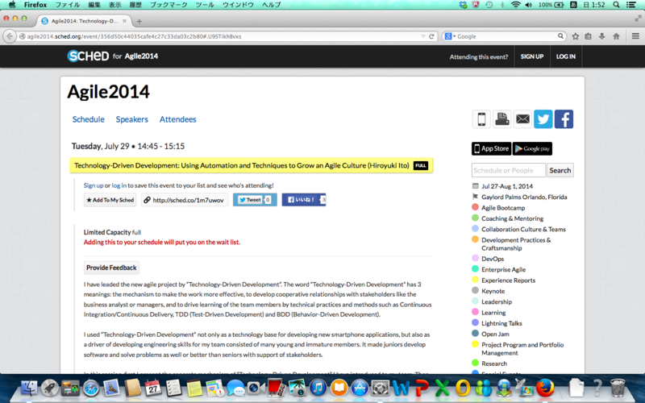
Before session

Slide 15
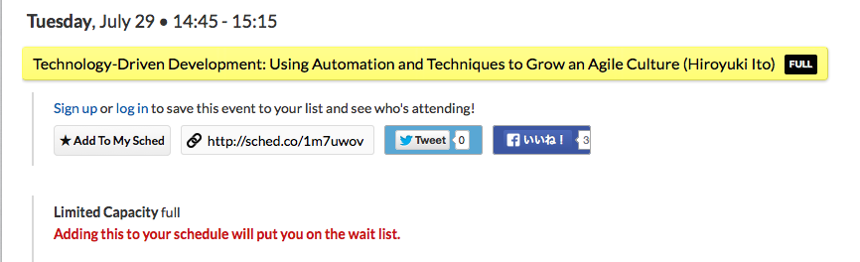
Before session (expanded)
Fully booked!?
(105 seats)

Slide 16
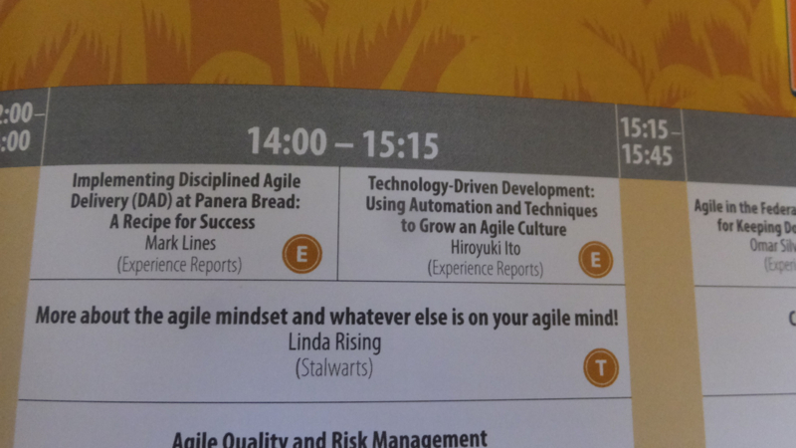
On session program

Slide 17
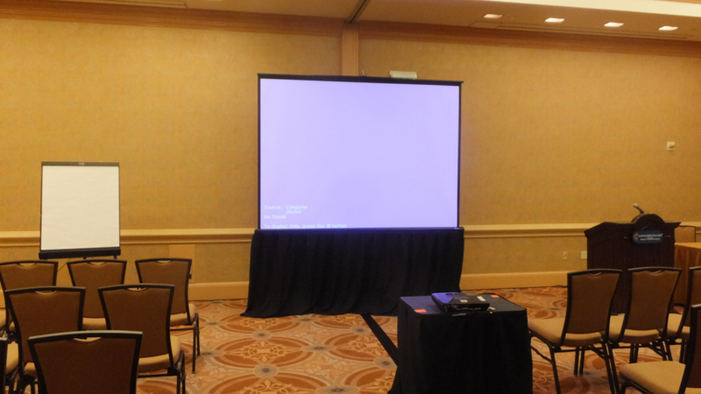
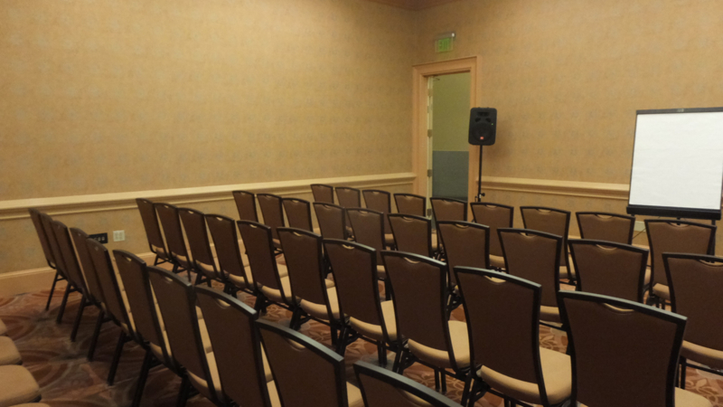
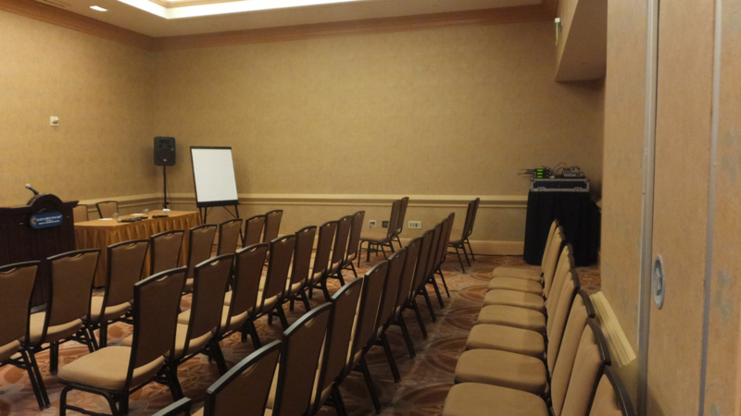
Venue

Slide 18
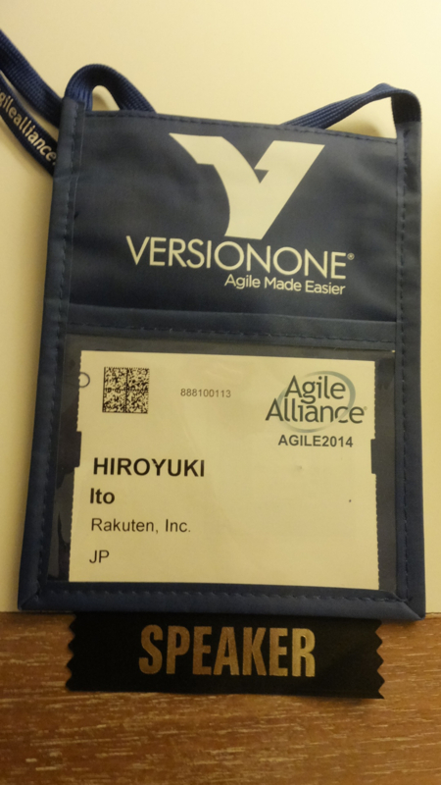
Key item as a speaker

Slide 19
Image of presentation

Slide 20
Result
About 60 persons attended.
Attendance Ratio = 57%
Average : about 50% (-> GOOD!)
Only 3 persons left during my presentation.
Remaining Ratio = 95%
Average : about 80% (-> GOOD!)
My shepherds often reacted positively during my presentation.
He is a real SAMURAI! (-> Maybe good ☺)

Slide 21
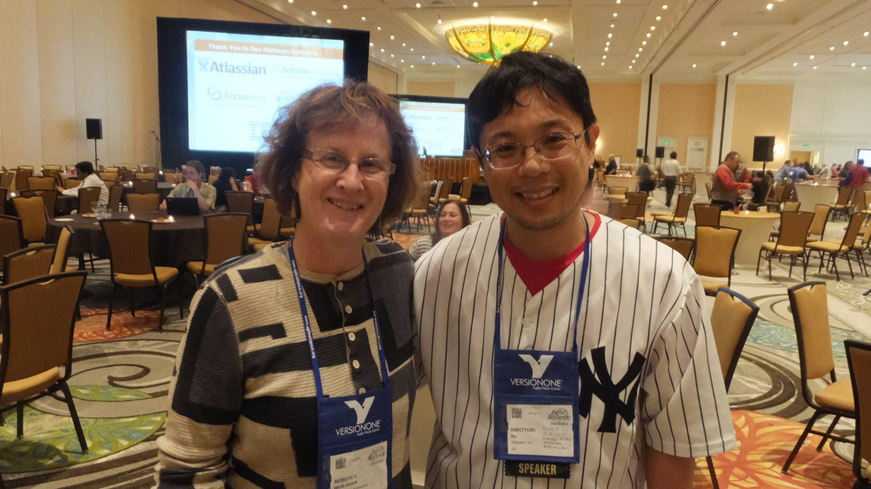
Rebecca Wirfs-Brock: Track chair

Slide 22
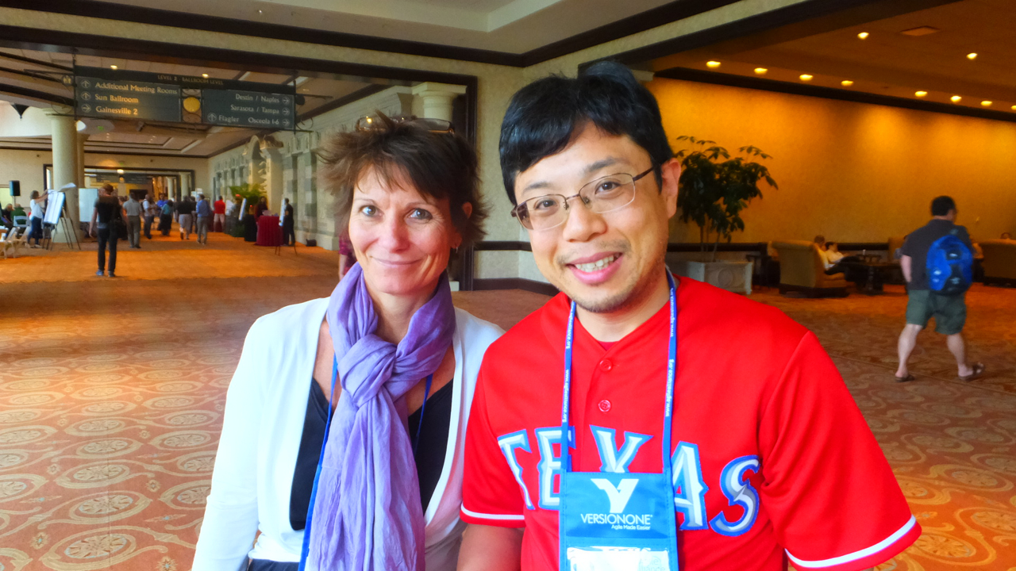
Jutta Eckstein: My shepherd

Slide 23
Impression
Englishnization is useful.
I had no trouble
making a presentation with English.
speaking in front of many English native speakers.
Practicing a presentation was very useful.
Feedback is very important before the real presentation.
Rakuten members gave me a lot of insightful feedbacks before the conference.
Writing a paper was very useful for
clarifying ideas got through your work.
acquiring how to think, evaluate, and explain objectively.
publishing ideas throughout the world easily and fast.

Slide 24
Next Action
Attend as a speaker again!
I have some themes
Advanced testing
Improve by metrics
Nurture younger members and colleagues
for consistent growth of our company.
Write and submit papers
Attend the next conference as a speaker

Slide 25
1. Basic Information of Agile2014
2. My Presentation
3. The Latest Trend of Agile
4. Conclusions

Slide 26
About 3 years ago
Value
Agile/Scrum/Lean

Slide 27
This year
Testing
BDD/ATDD/ET/MT
Metrics
CFD/Kanban/KPIs
Value
Enterprise Agile
Organizational Change/Psychology
Agile/Scrum/Lean

Slide 28
The latest trend of Agile
Agile, Scrum, and Lean are ordinary.
Most of practitioners are thinking about the better ways to utilize them more.
I found 3 big trends.
Organizational approach -> Enterprise Agile
Technical approach -> Testing
Combination of both -> Metrics

Slide 29
1. Enterprise Agile
Testing
BDD/ATDD/ET/MT
Metrics
CFD/Kanban/KPIs
Value
Enterprise Agile
Organizational Change/Psychology
Agile/Scrum/Lean

Slide 30
Ordinary Agile
Executives
Business
Analyst
Managers
UI/UX
Designers
Bottom-up
approach
Developers

Slide 31
Enterprise Agile
Top-down
approach
Executives
Business
Analyst
Managers
UI/UX
Designers
Decrease
silos
Developers

Slide 32
The trend of Enterprise Agile
Practitioner’s concern is changing
from improvement of development teams
to total optimization including executives and organization
Most of ideas are spiritual…
Not concrete…
Most of speakers just say the importance of changing mindset…
On the other hand, the influence of SAFe
(Scaled Agile Framework) is increasing dramatically.
There were about 5 sessions about SAFe.
★URL

Slide 33
Talked about EA with Erricson members
Bottom up でやっていくと、途中で middle 層や Executive 層に当たるのは普通。
基本、Control/Leadership 型の組織で起きる無駄を見つけて減らしていく活動、
Top down のアクションを促す上で、mindset などを伝えることには意味がある。それは buy in に役立つから。
一方で、Technical Foundation などの実践的裏付けなしでやること＆それでの失敗はやはり避けるべきだと考える。
Agile を考えるならば、Systems Thinking なども含めて必要

Slide 34
追記
基本、Control/Leadership 型の組織で起きる無駄を見つけて減らしていく活動、そこに含まれるメンバー・組織の mindset を変えていく話。
いずれも Agile の話だし、Enterprise Agile のテーマですね。
ただ、どうしても US のコンサルの話に基づきすぎると、ぼんやりした精神論に陥りがち。
経験談の積み上げをパターンにまで昇華させるのが結局の方向性か。
そういう意味では、metrics や BDD の話が以前よりも多く出てきており、確実に知見が蓄積しつつあると言える。
「精神論」とそれを支える technical foundation。そして全社までカバー範囲を広げることで、継続的改善が続く。
★科学的アプローチよりも経験主義的アプローチになりがちなので、学術的に知見を溜めにくい側面もあり。
★ちょうど良い記事あり。権限を下ろすための話として EA は出ている。一方で全てに同質＆実行の裏付けのないものが多いのでアレなのか。
http://toyokeizai.net/articles/-/43937

Slide 35
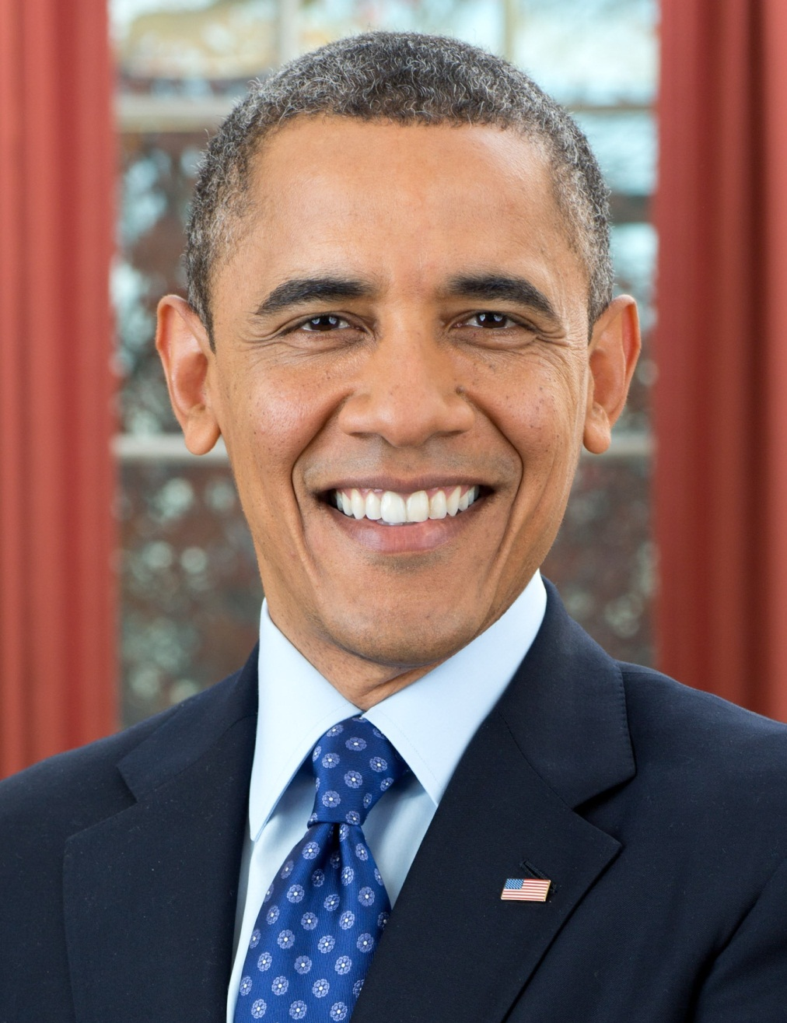
Changing mindset is very important, but…
YES, YOU CAN!

Slide 36
My idea
Technical
foundation
is necessary!

Slide 37




e.g.) Use automation for collaboration
Check-in build (hourly)
My PC
Deliver to
all team members
automatically
Build applications
and run regression tests automatically
We demonstrate latest application
to the business analyst and managers
in every daily scrum

Slide 38
Working software for building shared understanding
Developers
Business
Analyst
Know about
the progress
Get fast feedback
UI/UX
Designers

Slide 39
2. Testing
Testing
BDD/ATDD/ET/MT
Metrics
CFD/Kanban/KPIs
Value
Enterprise Agile
Organizational Change/Psychology
Agile/Scrum/Lean

Slide 40
The latest trend of Agile
BDD/ATDD
Exploratory Testing
Mutation Testing

Slide 41
Pattern of Automation
Specification by Example
●Use “examples” to build shared understanding
- Use Cucumber of other tools for SBE
- “Example” と “returnable specs” で、変更の traceability を確保する。
●Creating High-Level Scenarios
●Cross functional team for reducing rework
Page Object Patterns
https://code.google.com/p/selenium/wiki/PageObjects
Default Data
http://www.cheezyworld.com/2010/11/21/ui-tests-default-dat/
●４．Test Data Management
テストデータの投入にも次の３パターンがある
- 各ケースに必要なものだけを都度用意して rollback する
- 全データを用意＆rollback する
- 全ケースを実施し、データを commit して残す

Slide 42
Exploratory Testing
- ET の考え方の指針をキチンと示してくれたこと、またデモをしてくれた点が＋。
- Test base のヒントはもらったが、これを溜めていくことが（少なくとも SET 観点からは）まだまだ大変そう。
- 一方で、QA と collaborate することでこの辺りの知見を溜めていければ、各社独自の Test base/culture を作れるのではないか？
ATDD のセッションでも感じたが、ここでの考え方の軸を元に testable & clear specification を作っていければ、synergy が期待できるのではないか？
1) trade-off manual and automated testing
2) session-based test management
http://www.satisfice.com/articles/sbtm.pdf
3) test charters
http://www.qualitestgroup.com/howTo/How-to-write-an-Exploratory-Test-Charter
4) heuristics
http://testobsessed.com/wp-content/uploads/2011/04/testheuristicscheatsheetv1.pdf
http://www.satisfice.com/tools/htsm.pdf

Slide 43
Mutation Testing
●発表資料
http://schd.ws/hosted_files/agile2014/c1/1435_Mutation_Test_-_A_New_Way_to_Improve_Code_and_Test.pdf
●Definition of Mutation Testing by Parasoft
http://www.parasoft.com/products/article.jsp?articleId=291
●Explanation about Mutation Testing on Wikipedia
http://ja.wikipedia.org/wiki/%E3%83%9F%E3%83%A5%E3%83%BC%E3%83%86%E3%83%BC%E3%82%B7%E3%83%A7%E3%83%B3%E8%A7%A3%E6%9E%90
●Mutant の基準
http://pitest.org/quickstart/mutators/
●日本語による分かりやすい説明
http://d.hatena.ne.jp/takehikom/20120829/1346252399
●PIT (tool for Mutation Testing, Java)
http://pitest.org/
●Research of Mutation Testing
http://crestweb.cs.ucl.ac.uk/resources/mutation_testing_repository/

Slide 44
Next Action
●Study more about BDD
based on SBE
●Create Synergy among QA section members about
BDD
ET
MT

Slide 45
3. Metrics
Testing
BDD/ATDD/ET/MT
Metrics
CFD/Kanban/KPIs
Value
Enterprise Agile
Organizational Change/Psychology
Agile/Scrum/Lean

Slide 46
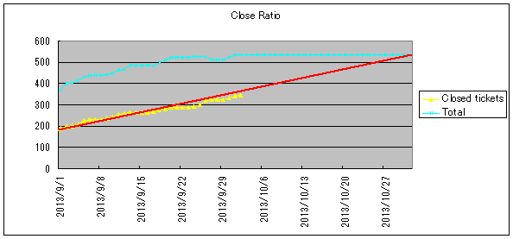
Example of metrics
Change requests : 3 times/week
Regression testing : 3 minutes/change
Install applications : 2 minutes/change

Slide 47

http://books.rakuten.co.jp/rk/91a2285c6f0b4fea867632bcd286bf1d/

Slide 48
Increasing
Do the same thing in software product
Find problems and know progress
Clarify the biggest point to improve!

Slide 49
“Useful Metrics in a Complex World” by Ken Power
Metrics for understanding “FLOW”
- Based on his experience
●points
- What perspective to measure?
- What does work flow?
What impedes the flow of work?
1) cumulative flow
- どこに問題があるか、何が velocity を止めているかを突き止めるのに役立つ
- Know information by trend（変化から意味を見いだす）
- 傾きから、今後の動きの仮説を立てる
2) throughput analysis
- 中々進捗が上がらない！という状況を知るのに有益。
- Distinguish the failure demand and value demand!
★まだ情報は掘ることが出来る！
3) cycle time
- 各 status でどの程度状況が違うか／時間がかかっているかを知ることができる
- 改善したのに時間がかかっているという場合に情報を得るのに有用
prisoner metrics?
●Point to use metrics
- Review continuously
**所感
- The basic idea of metrics is to find problems and know progress.
- Metrics の変化から意味を見いだす。
- 他の人の数値の取り方は非常に役立つ。
誰が取るのか？ははっきり決めた方が良いかも
**参考資料
●Ken’s paper
http://www.agilealliance.org/files/9814/0509/9343/ExperienceReport.2014.Power.pdf
●Prisoner Metrics
https://leanpub.com/prisonersmetrics/

Slide 50
MoneyBall
内容大杉。みんなでみてみて。
●公開資料
http://schd.ws/hosted_files/agile2014/f0/1272_Agile_2014_-_Software_Moneyball_%28Troy_Magennis%29.pdf#page=1&zoom=auto,-72,540
●The Seven Deadly Sins of Agile Measurement: Introduction and Sin #1
http://www.rallydev.com/community/agile/seven-deadly-sins-agile-measurement-introduction-and-sin-1
●Weibull analysis
http://ja.wikipedia.org/wiki/%E3%83%AF%E3%82%A4%E3%83%96%E3%83%AB%E5%88%86%E5%B8%83
●Benford’s Law (First-Digit Law)
http://en.wikipedia.org/wiki/Benford%27s_law
●Scrum Sim & Kanban Sim
http://focusedobjective.com/kanbansim-and-scrumsim-v1-1/
●おそらく speaker のサイト
http://focusedobjective.com/

Slide 51
Next Action
・経営学＆科学的手法で実施している、
改善の仕組み化としてのMetricsは取るべし
・勉強会を始めるつもり

Slide 52
1. Basic Information of Agile2014
2. My Presentation
3. The Latest Trend of Agile
4. Conclusions

Slide 53
The world’s largest conference of Agile
Agile is a continuous improvement action & process that can adopt the whole things.
PDCA cycles
Less up-front rules
Create rules & processes by team members (mature)
Retrospectives
Based on numerical measurement
Anything is ok to improve (automation, non-technical process)
for whole team/organization/company

Slide 54
The world’s largest conference of Agile
●上記をベースとすれば、その時に問題と感じているところを明確にし、それに関する Agile の情報を収集すれば良いと言える。
或は、各領域の知見の集積に敏感になることが重要か。
- 本質そのものは変わらない。
一方で、本質を自力でやれるようにすることはどうしようもなく難しい。
ここは、今後もコーチングで改善を図るつもり。

Slide 55
The world’s largest conference of Agile
●いずれについても言えるのは、
- Framework は役に立つ
- チーム毎に異なる部分は自力で考えろ
- 考える範囲が広がりつつある
- 多くの論文が出始めている。これらを徹底して取り込んでいき、我々の形を作るべき。
- Metrics & BDD については、勉強会を開催していくつもり。

Slide 56
The world’s largest conference of Agile
●8/1 追記
基本、Control/Leadership 型の組織で起きる無駄を見つけて減らしていく活動、そこに含まれるメンバー・組織の mindset を変えていく話。
いずれも Agile の話だし、Enterprise Agile のテーマですね。
ただ、どうしても US のコンサルの話に基づきすぎると、ぼんやりした精神論に陥りがち。
経験談の積み上げをパターンにまで昇華させるのが結局の方向性か。
そういう意味では、metrics や BDD の話が以前よりも多く出てきており、確実に知見が蓄積しつつあると言える。
「精神論」とそれを支える technical foundation。そして全社までカバー範囲を広げることで、継続的改善が続く。
★科学的アプローチよりも経験主義的アプローチになりがちなので、学術的に知見を溜めにくい側面もあり。
★ちょうど良い記事あり。権限を下ろすための話として EA は出ている。一方で全てに同質＆実行の裏付けのないものが多いのでアレなのか。
http://toyokeizai.net/articles/-/43937

Slide 57

http://agile2015.agilealliance.org/

Slide 58
Reference
Program of Agile2014
★URL
Papers and resources by Agile Alliance
★URL
My blog (Japanese)
http://d.hatena.ne.jp/hageyahhoo/20140730/1406683408

